Slide 1
Push Pull factors
Migration

Slide 2
What is Migration?
The movement of a person or a group of people, to settle another place, often across political and administrative boundaries.
It can be
Temporary or Permanent
Voluntary or forced

Slide 3
What are causes of migration?
Push and Pull Factors
Push Factors:
Force a person to move away from a place because of things like conflict, drought, famine, or extreme religious activity.
Pull Factors:
Factors in a country that attract a person or group to leave their home country.
Opportunities, jobs, promise of a better life.

Slide 4
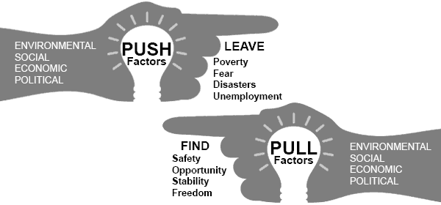
Four types of Push/Pull Factors
Economic:
Push: Unemployment, low wages, poverty, low standard of living
Pull: High wages, High Standard of Living, High demand for labor
Political:
Push: Conflict (Civil War), Human Rights Violations, Oppression of Minorities, Dictatorships
Pull: Democracy, Political Stability, Peace, Protection of Human and Civil Rights
Social:
Push: Inadequate education systems, Lack of social security, uncontrolled population growth
Pull: Stable population, Welfare State Benefits, Strong Education System
Environmental:
Push: Natural disaster, lack of resources, water shortage
Pull: Better environment, protection of natural resources

Slide 5
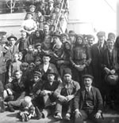
Historical Examples of Migration: Italians to North America
In the 1880’s 300,000 Italians lived the United States
By 1920: More than 4 Million Italians lived the US, Why?
Lots of internal strife
Social Chaos and violence
Widespread Poverty
Diseases and Natural disasters affecting the poor and no government assistance
More affordable to purchase a transatlantic ticket
Reaction By the US: Emergency Quota Act 1924
What were the Push/Pull Factors? Was their migration voluntary or Forced? Permanent or Temporary?

Slide 6
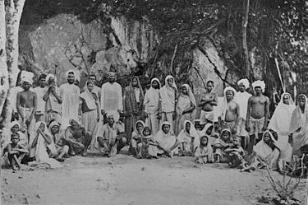
Historical Examples of Migration: Indians in East to Southern Africa, Caribbean and Southeast Asia
India was a Colony of Great Britain
When Slavery ended in 1840s, European Nations needed cheap labor
European Recruiters promised Indian workers gold and wealth if they signed up to work in other European owned colonies.
Indian workers were tricked and forced into indentured servitude.
As many as 3.5 million Indians were transported to various colonies of European powers to provide labor on mainly sugar plantations.
Of the 32,000 sent to Africa only 7,000 chose to stay
What were the Push/Pull Factors? Was their migration voluntary or Forced? Permanent or Temporary?

Slide 7
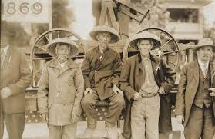
Historical Examples of Migration: Chinese to South East Asia, Caribbean, South America, and North America
Chinese were in search of work during the latter half of the 19th Century.
Sought opportunities in agricultural and transportation industry.
South East Asia:
Malaya: Controlled Opium distribution
Dutch East Indies: Held Colonial Government Office
French Indochina: Heavily engaged in commerce
The Americas:
US: Came during the Gold Rush and worked on building Railroads
Cuba and Peru: Went to work on Plantations after the abolishment of slavery. Stayed for temporary contracts.
Reaction of People: Chinese Exclusion Act
What were the Push/Pull Factors? Was their migration voluntary or Forced? Permanent or Temporary?

Slide 8
Now it’s your turn….
Using the sheet provided and the resources listed…
Write down the Push/Pull Factors of the British to Australia and New Zealand
What type of factor were they? (Social, Political, Economic, Environmental)
How did people get there? What were the challenges they faced?
How were the migrants or natives of the area treated?

Slide 9
Wrap it up…
Come up with a thesis for this prompt…
Develop an argument that evaluates how similar the experiences of British migrants to Oceania were to other migrants during the time period of 1750-1900.

