Slide 1
SSWH19
The student will demonstrate an understanding of the global social, economic, and political impact of the cold war and decolonization from 1945-1989.

Slide 2
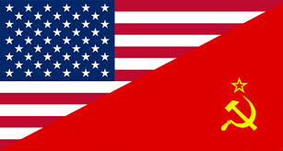
Cold war: 1945-1991
US and USSR emerge world war ii as superpowers
Began in europe
Each formed a european military alliance made up of countries that it occupied or protected (us: nato, ussr: warsaw pact)
Disagreed over government in europe:
*us= democracy
*ussr= communism

Slide 3
Cold war:
“cold” no weapons or shots fired between the two countries
Faced each other in combat in other countries (korea, cuba, china, vietnam)
Iron curtain: tense line between the democratic west & communist east

Slide 4
revolutionary movements: china
China was left in chaos after WWI
Had many countries bringing foreign influence into the country
Influenced by the Soviet Union, certain individuals were trained and the Chinese Communists political party was created
1921: Sun Yixian/Guomindang (Nationalist Party) came to power in South China
Sun wanted to spread his govern. all over China

Slide 5
Revolutionary movements: china
Chiang Kai-shek (Jiang Jieshi):
*came to power after Sun
*wanted to reunite China
*wasn’t interested in communism or democracy
*would take over northern China with the help of the communists, and take control of a new government, without the Communists
began to see Communist Party as a threat to his power
civil war will erupt between the Communists & the Guomindang

Slide 6
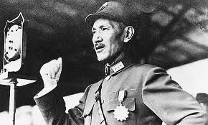
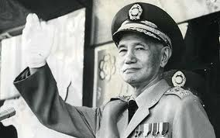

Slide 7
Revolutionary movements: china
Mao Zedong:
*born of peasant origin
*thought Communists should look for support among the large peasant class
*led Chinese Communists against Kai-shek (Long March)
*beat Kai-shek and would impose revolutionary ideas on China

Slide 8
Revolutionary movements: china
Created the People’s Republic of China
The defeated Nationalists fled to Taiwan
Made China communist, a one-party totalitarian state

Slide 9
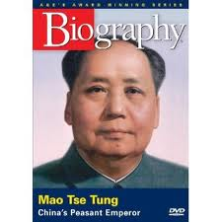

Slide 10
Revolutionary movements: india
Mohandas Gandhi:
*Born into a Hindu family
*faced discrimination
*became leader of Congress party
*practiced nonviolence (ahimsa) to bring about change
*civil disobedience: refusal to obey unjust laws
*could not change India from religious conflicts between the Hindus and Muslims
The Salt March:
*Gandhi organized mass support to boycott British salt
*Gandhi & 78 followers marched 240 miles to the sea to get salt
*arrested & jailed
*British look bad in public eye
*British forced to hand over some control over salt industry

Slide 11
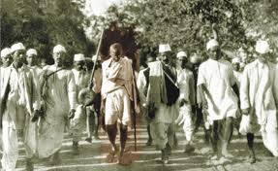

Slide 12
When India was granted its independence, it was partitioned into two countries:
*India (Hindu)
*East (now Bangladesh) and West Pakistan (Muslim)
Although the current governments have had success in feeding their over 1 billion inhabitants, many problems exist between the countries, including:
*ethnic and religious conflict
*a nuclear arms race
*dispute over the northern provinces of Kashmir and Jammu

Slide 13
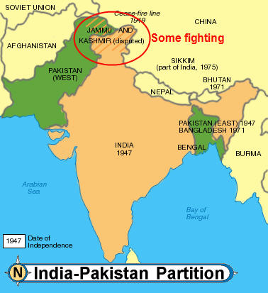

Slide 14
Revolutionary movements: india
Jawaharlal Nehru: Prime Minister
(1947-1964)
promoted economic growth & social change
caught in middle of argument division of
India (Pakistan)

Slide 15
Revolutionary movements: india
Indira Gandhi: Prime Minister
(1966-1984)
Nehru’s daughter
tough ruler & challenged discrimination against women

Slide 16
Revolutionary movements: ghana
Kwame Nkrumah:
led nationalist movement in Africa
Ghana was the first African nation (south of the Sahara) to win independence
supported socialism
left Ghana in large debt
government became corrupt
http://www.youtube.com/watch?v=P-BzMayiGCw

Slide 17
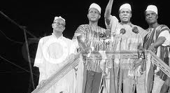

Slide 18
Writing-to-win: nonviolence
You will think of a law that you do not agree with in your community (ex. Seatbelts, no texting while driving, etc.).
1st Paragraph: You will explain the law and why you disagree with it (NOT BECAUSE YOU JUST DON’T LIKE IT)
2nd Paragraph: Explain how you would go about having this law changed, nonviolently
3rd Paragraph: Explain how using nonviolence, like Gandhi and Martin Luther King Jr. can prove to be successful at changing people’s minds

Slide 19
Israel:
Britain controlled Palestine and was in favor of an Israeli homeland inside Palestine.
Holocaust caused worldwide support for a Jewish homeland
1947: UN draws up a plan to divide Palestine into an Arab state and a Jewish state—Arabs reject plan
1948: Britain withdraws from Palestine & Jews set up the independent State of Israel

Slide 20
Israel:
Obstacles to peace:
1. Land
2. West Bank
settlements
3. Jerusalem

Slide 21
Israel:
Arabs in Palestine will launch 3 wars against the Jews, failing to defeat Israel
Israel gains more land
Arabs left their homes in Israeli territory & Jews from Arab lands were driven from their homes (displacement)
1973: gains the West Bank, Jerusalem, and the Gaza Strip
Palestinian Liberation Organization (PLO); headed by Yasir Arafat
PLO in support of destruction of Israel
Began using violence (airplane hijacking, killing, suicide bombers, 1972 Olympic Games)

Slide 22
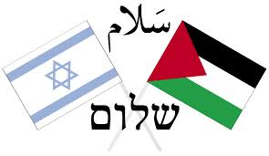
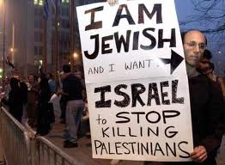
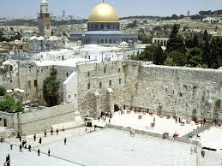
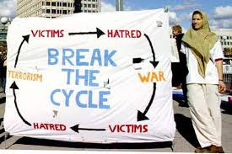
Peace? 1993: Oslo Accords (plan of peace among Arabs and Jews) PLO recognizes Israel’s right to exist Israeli Prime Minister dies; fighting continues

Slide 23
Writing-to-win:
Do you think that Jews have a right to their own country? Why or why not?
Do you think it is fair that they chose Palestinian lands? Why or why not?
Do you believe that the Israeli settlements in Palestinian territories is a violation of international law? Why or why not?
1 PARAGRAPH FOR EACH QUESTION!

Slide 24
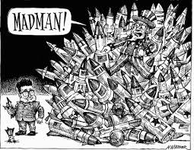
Arms race:
Competition between countries to achieve superiority and quality of military arms
Example:
United States v.
Soviet Union (COLD WAR)
United States was first nuclear power after WWII (dropping of atomic bombs)
1949: Soviets develop atomic bomb

Slide 25
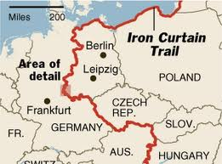
Arms race:
Race was all about matching each other’s newest weapons
Agreement created to limit the number of ABMs (anti-ballistic missiles)—missiles that could shoot down other missiles
Allowed for protection
“Iron Curtain:” imaginary wall that divided East and West Europe (pg. 966)
Quote spoken by Winston Churchill

Slide 26
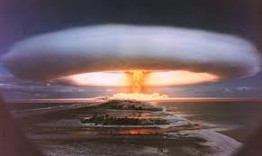
Hydrogen bomb:
1953: Both the US and Soviet Union had developed a hydrogen bomb
Much more destructive than an atomic bomb
Created a “balance of terror”
Both sides knew if they launched their weapons, they too would be destroyed
This helped to discourage nuclear war

Slide 27
Salt:
Both sides wanted to reduce the threat of nuclear war, so they met for disarmament talks
1969: Strategic Arms Limitation
Talks (SALT) where the US and
Soviet Union began to limit the
number of nuclear weapons held
by each side
1972 & 1979: both sides signed
agreements setting these limits

Slide 28
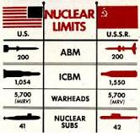

Slide 29
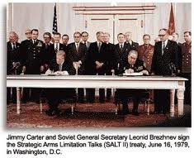
Salt:
Leads to an era of détente (relaxation of tensions)
US wanted to restrain the USSR through diplomatic agreements, not military force
Era of détente ends in 1979 when the Soviet Union invaded Afghanistan

Slide 30
Space race:
USSR used resources in science and technology and launched Sputnik I, the first artificial satellite in space (1957)
US concerned and began stressing math and science in the American school systems

Slide 31
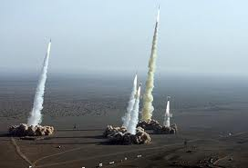
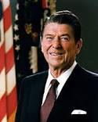
In the end:
The arms race put a strain on Soviet economy
Ronald Reagan launched a new round of missile development in the US, and it became clear that the Soviets could not keep up

Slide 32
Nikkita Khrushchev:
Soviet leader after Stalin
Denounced Stalin’s abuse of power (such as purges)—closed prison camps
Domestic changes:
*deStalinization: process of reforms
*loosened govern. Censorship
*gave people more power to make economic decisions
*restructured collective farms

Slide 33
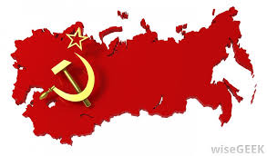
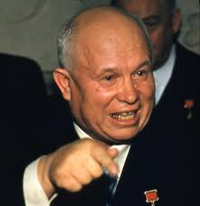
Khrushchev:
Foreign changes:
*”peaceful coexistence” with US
Supported Cuba & Castro
Involved in Cuban Missile Crisis: USSR & Khrushchev placed long-range missiles inside of Cuba, pointed towards the United States (closest US and USSR got to going to war)

Slide 34
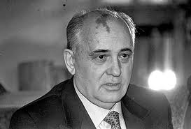
Mikhail gorbachev:
1985: came to power in Soviet Union
Considered more “western”
Wanted reforms; created 3 level plan:
1. glasnost: means “openness;” allowed open discussions of political, social, and economical issues & allowed criticism of the government
2. democratization: wanted to keep Communist Party, yet insert some democratic ideas (direct election of representatives)
3. perestroika: most radical & least successful; transferred economic power from the central govern. to private hands
http://www.youtube.com/watch?v=-W1QBin4hHM

Slide 35
Khrushchev v. gorbachev
PAGES:
971-972, 1000, 1010
PAGES:
998,1002-1005

Slide 36
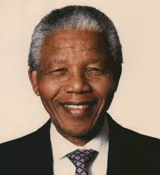
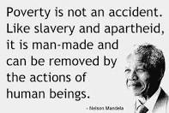
PURSUIT OF FREEDOM: AFRICA
1910: South Africa achieved self-rule from Britain
Only applied to whites (made up <20% of population) but
controlled the government
1948: White government expands segregation creating an apartheid (separation of the races)
African National Congress (ANC): party that opposed apartheid
*used boycotts, strikes, and marches (peaceful)
Nelson Mandela

Slide 37
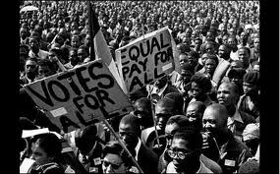
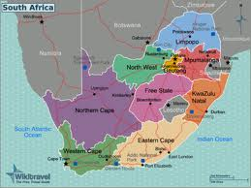
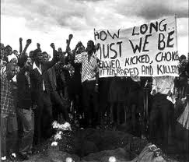
South africa:

Slide 38
http://www.youtube.com/watch?v=UqoYmx_L-Xs http://www.youtube.com/watch?v=AqKjVo-9qso

Slide 39
Pursuit of freedom: china
Page 1076 in textbook

Slide 40
Pursuit of freedom: china
Tiananmen Square:
-large, public plaza in Beijing, China
-1989: thousands of protesters (mostly students) called for democracy
-government asked protesters to leave, they didn’t & gov. opened fire killing hurting thousands
-showed that communist govern. Was determined to keep control

Slide 41
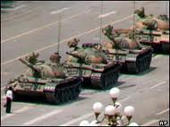
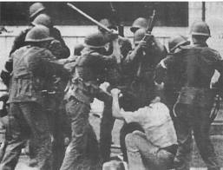
Tiananmen Square massacre:

Slide 42
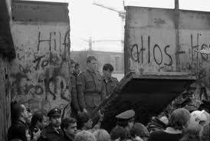
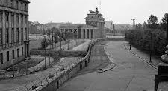
Pursuit of freedom: germany
Berlin Wall:
-constructed after WWII
-divided East & West Berlin
-East: Communist
-West: democratic government
-referred to as the “Iron Curtain”

Slide 43
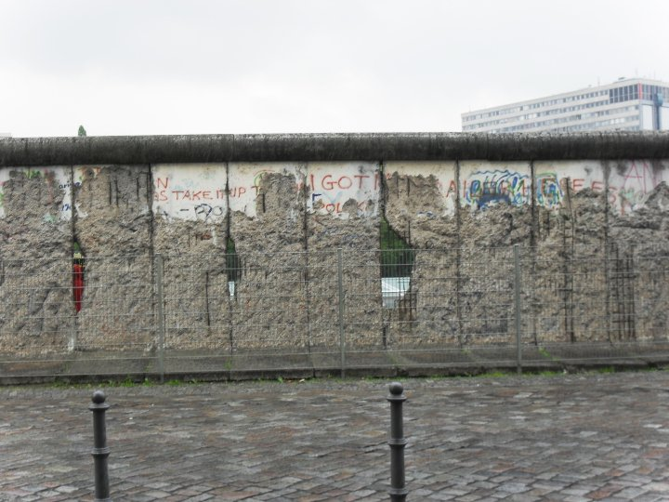
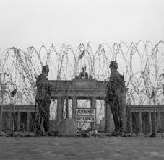
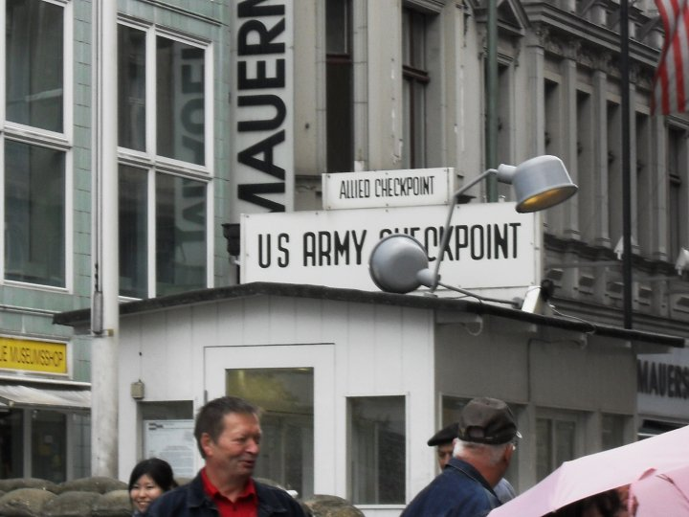

Slide 44
Pursuit of freedom: germany
June 12, 1987:
-Reagan challenged Gorbachev to get rid of the wall
1989:
-peaceful protests to get rid of wall by Germans
Nov. 09, 1989:
-the fall of the wall
Significance: first step towards German reunification

