Slide 1
Rome: Location and Geography

Slide 2
Rise of the Republic
Republic
a government in which elected officials have power granted by voting citizens
Senate

Slide 3
Julius Caesar
Triumvirate
Along with 2 others, Caesar had control of Senate
The other members of the Senate feared he was getting too powerful, so they killed him.
Started Civil War

Slide 4
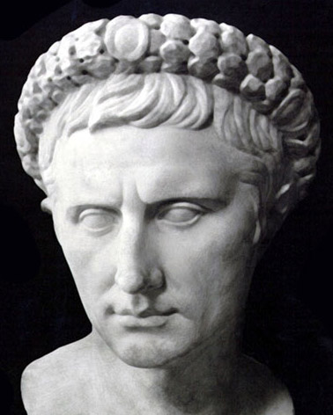
Octavian
Ended the Civil War and took over the government
Became the First Emperor of Rome
Took the name Augustus Caesar

Slide 5
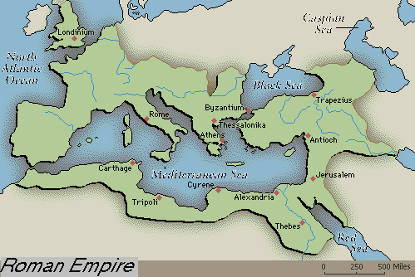

Slide 6
Roman Empire
Autocratic government led by one leader who rules a number of peoples or countries
Caesar = Emperor
Pax Romana
Period of Roman Peace that lasts for 200 years
Vast trade networks (Roman Roads)
Lots of cultural diffusion!

Slide 8
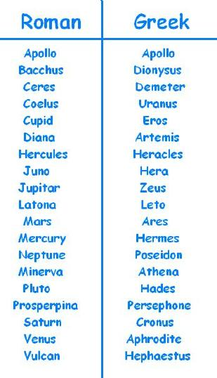
Roman Religion
Polytheistic
Borrowed Greek Religion and changed the names of the gods and goddesses

Slide 9
Christianity
Messiah
Jewish belief that God would send someone to Earth to lead them to Heaven.
Jesus of Nazareth
Lived in the Middle East (part of Roman Empire)
Thought by some to be the messiah
Made enemies of Jewish and Roman leadership because he was so popular with the common people.

Slide 10
Christianity
Appeal:
embrace all people
personal relationship w/ God
promise of Heaven
Christianity spread through empire easily b/c of Pax Romana
Paul
Early apostle and missionary for the Christian religion.
Christians not liked by Romans b/c refused to worship Roman gods

Slide 11
Spread of Christianity
Late 300 CE, lots of Christians in Roman Empire
Persecution
Hurting someone because of his/her beliefs
312 CE, Roman Emperor Constantine ends persecution of Christians b/c of vision
380 CE made official religion of Rome

Slide 12
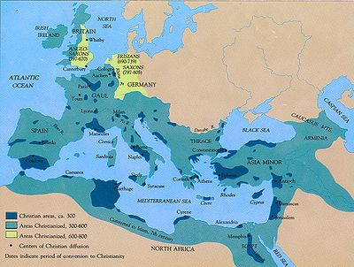

Slide 13
Roman Life
Most lived in countryside
Slaves important
First major empire to be economically dependent on slavery
POWs and debtors
Big difference between rich & poor

Slide 14
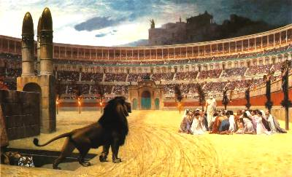
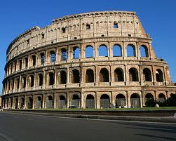
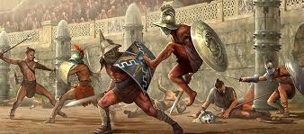
Entertainment
Coliseum
Arena w/ free entertainment
Gladiators

Slide 15
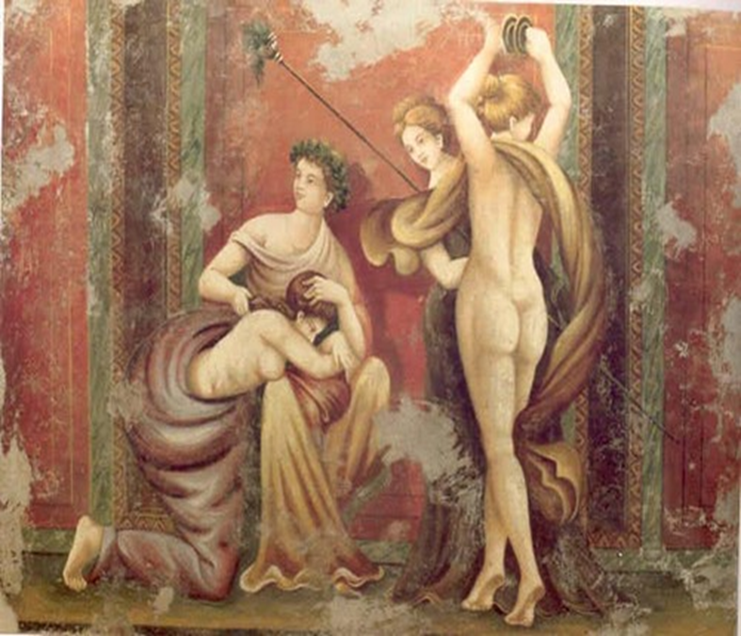
Arts and Literature
Romans adopted sculpture from Greeks
Mosaics and frescos

Slide 16
Roman Influences
“Western Culture”
Greco-Roman culture that spread Europe America
Latin
Official language of Roman Empire.
Basis of Romance Languages and half of English words

Slide 17
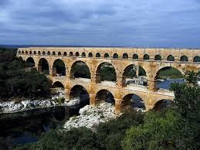
Roman Influences
Architectural structures- arch, dome, aqueducts
Roman laws that we use today:
innocent until proven guilty
equal treatment under law

Slide 18
Decline of the Roman Empire
Empire becomes weakened over time
Factors:

Slide 19
Split
To try to save the empire, it was split in the 3rd century to make it easier to rule
Western Roman Empire
Capital at Rome
Eastern Roman Empire
Capital at Constantinople
Became known as Byzantine Empire later

Slide 20
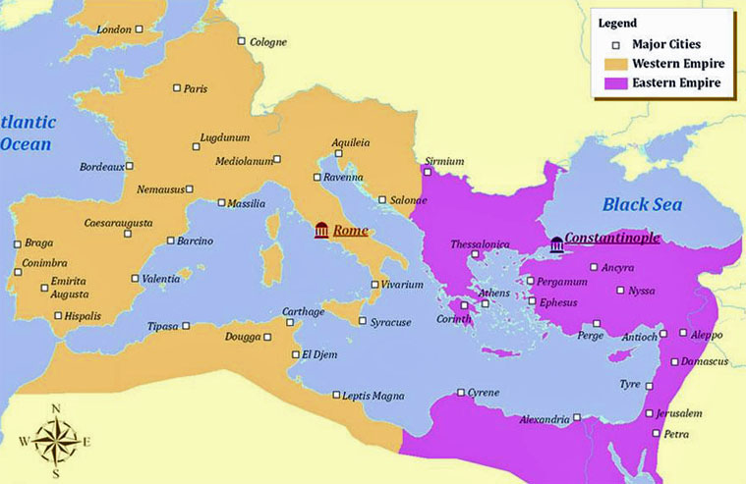

Slide 22
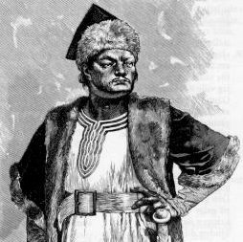
Fall of Western Empire
Huns
One of the many nomadic tribes that led multiple raids into the W. Roman Empire
Led by Attila the Hun
Rome surrendered to the attacks in the 5th century

